Slide 1
Publishing biodiversity data through IPT2
Alan Yang, Kun-Chi Lai, Lee-Sea Chen
Biodiversity Research Center, Academia Sinica

Slide 2
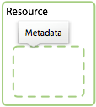
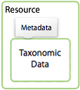
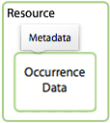
Outline
Integrated Publishing Toolkit (IPT)
Publishing Primary Data
Metadata, Exercise 1 and 2
Source Data (text, SQL) Exercise 3
Source Mappings Exercise 4
Published Release
Visibility
Exercise 5
External
Data

Slide 3


Menu Bar Authorization
Before login or logging in with no special role
After a user having a Manager role logs in
After a user having the Admin role logs in
Click to activate the topic
Notes:
Some tabs are only visible when a user having the appropriate rights to see them is logged in.

Slide 4
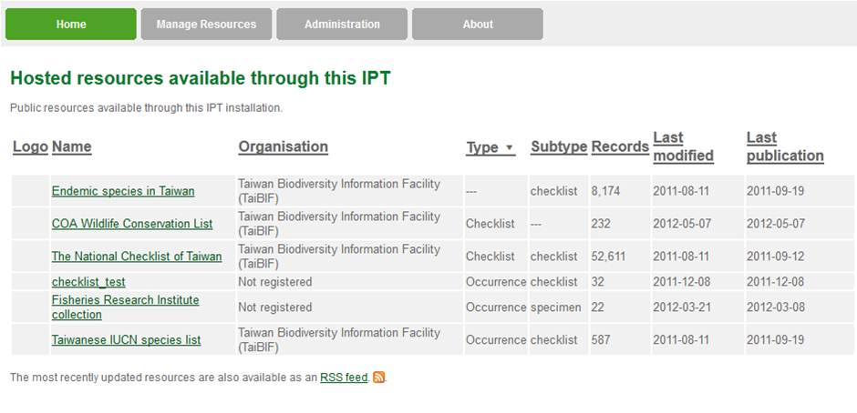
Home Menu (visible to all users)

Slide 5
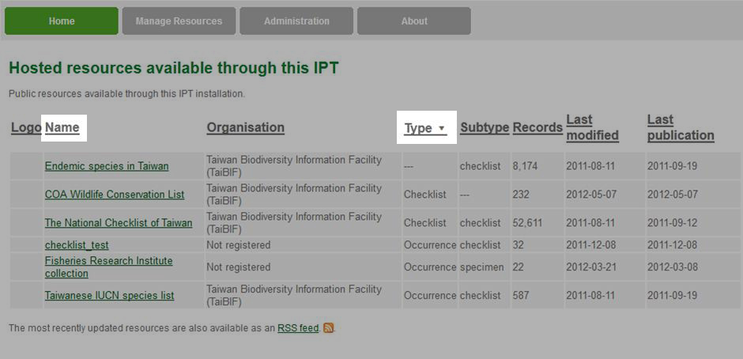
Home Menu (visible to all users)
Click to sort table by "Name"
Table sorted in ascending order by “Type”

Slide 6
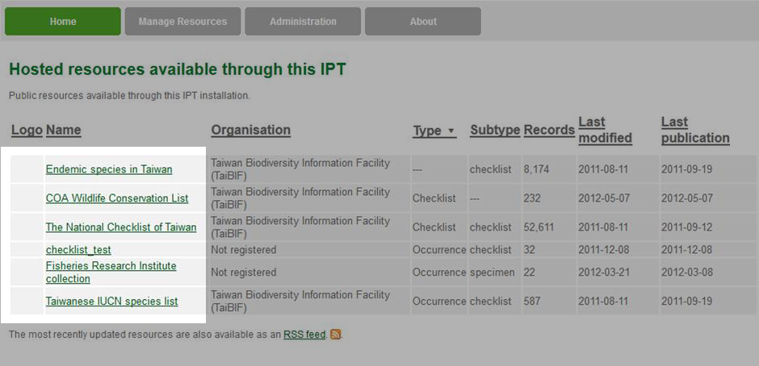
Home Menu (visible to all users)
Names of resource folders

Slide 7
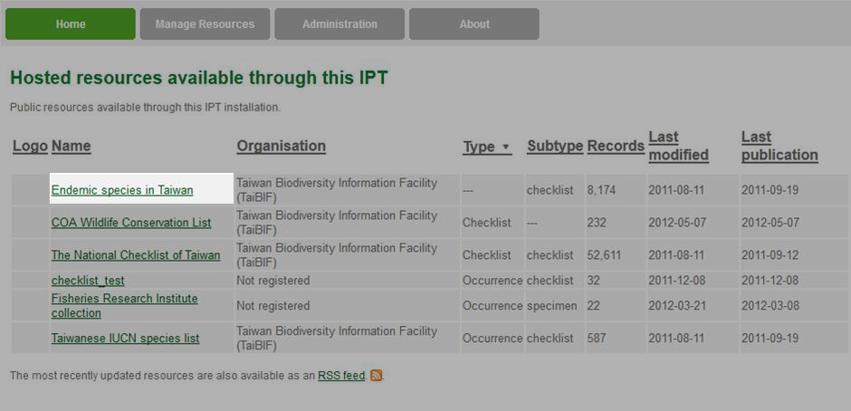
Home Menu (visible to all users)
Click to view the detailed metadata

Slide 8
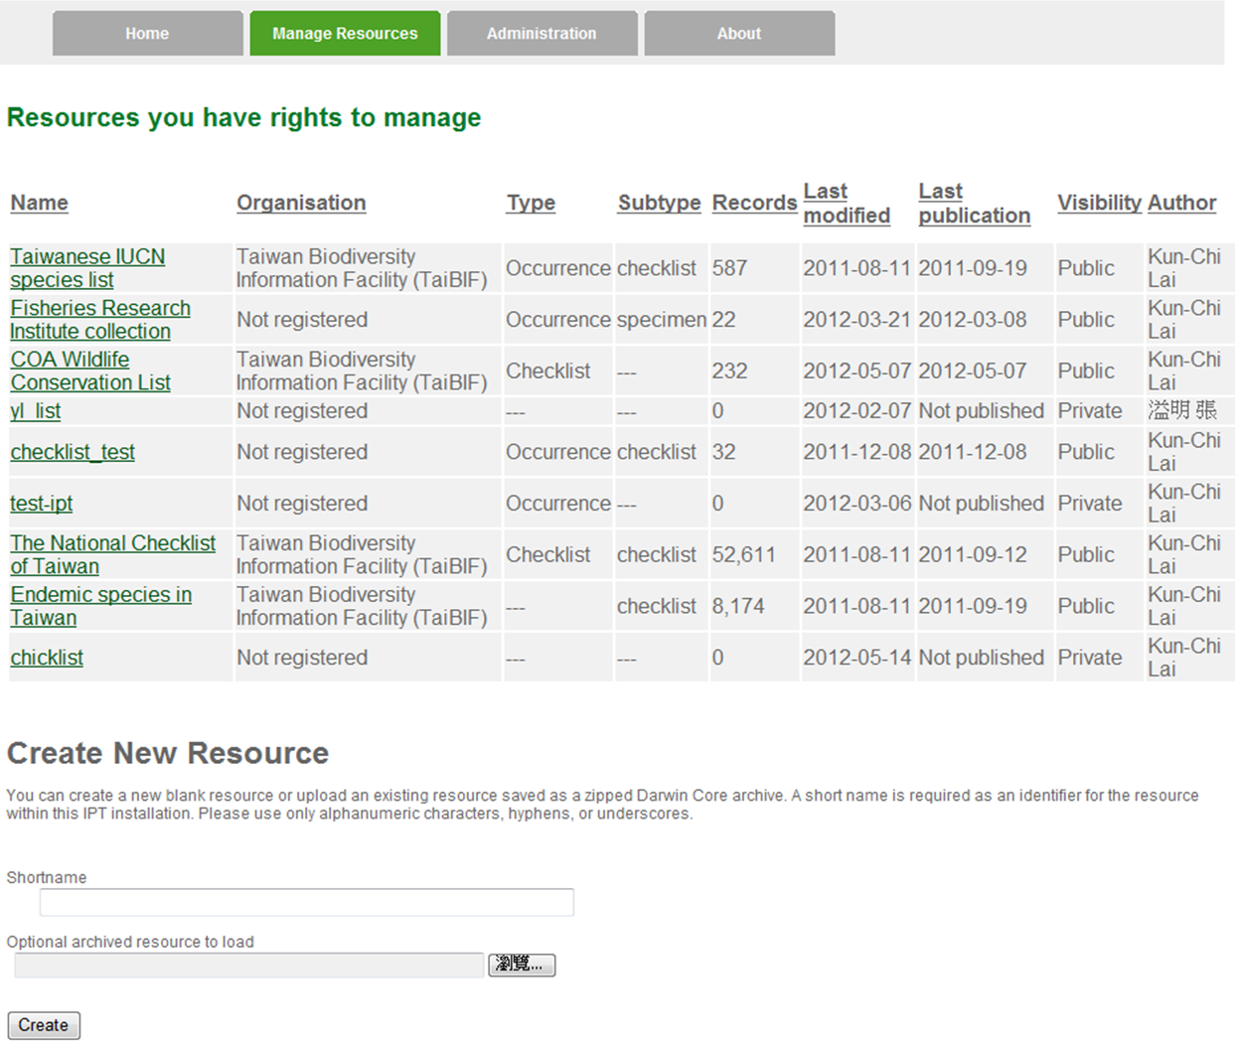
Manage Resources Menu (visible to authorized users only)

Slide 9
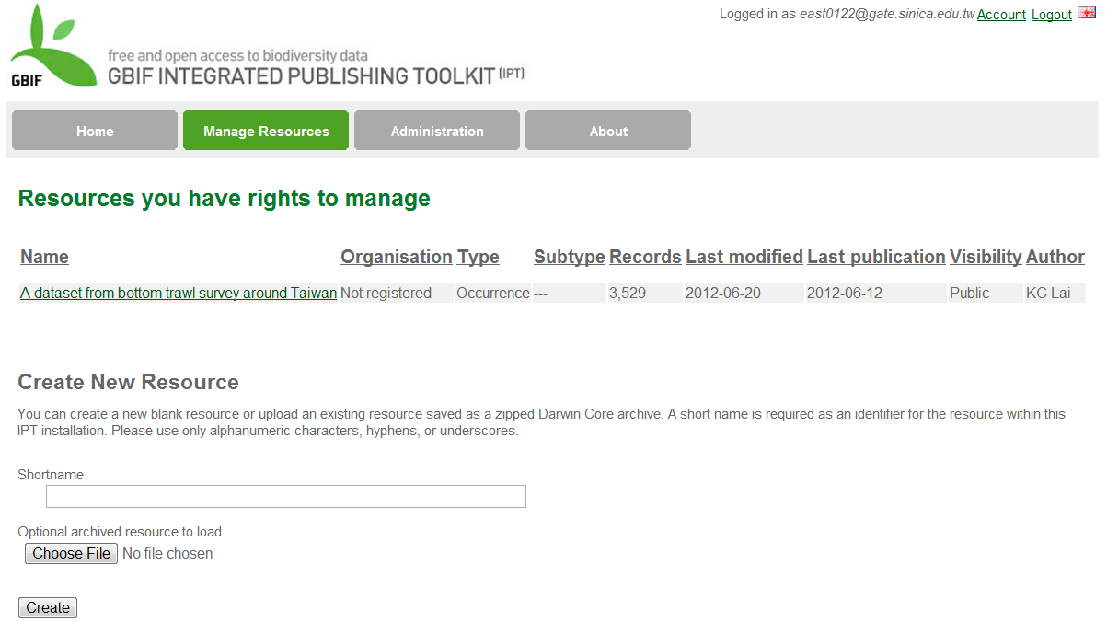
Manage Resources Menu (visible to authorized users only)
The shortname must be at least three characters in length
Notes:
有需要嗎?可否刪除

Slide 10
3 Ways to Create a New Resource source
Upload a Darwin Core Archive
Integrate an existing resource configuration folder (advanced users only)
Create an entirely new resource

Slide 11
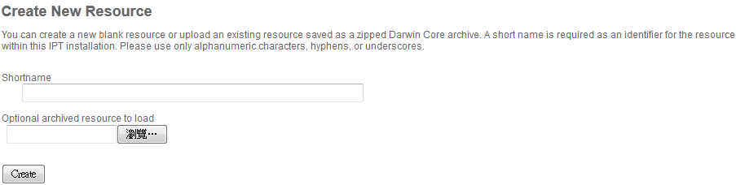
Upload a Darwin Core Archive Archive
1. A Shortname is required
Choose
File
2. Select a zipped Darwin Core archive (up to 100MB in size)
3. Create a new resource folder

Slide 12
Integrate an Existing Resource Configuration Folder (advanced users only)
Create a new resource folder
Shut down the IPT
Copy the contents of the resource folder you wish to integrate into the new folder, making sure to replace the newer resource.xml file with the original from the resource being integrated
Restart the IPT
advanced users only

Slide 13
3) Create an Entirely New Resource
1
The shortname must be at least three characters in length
2

Slide 14
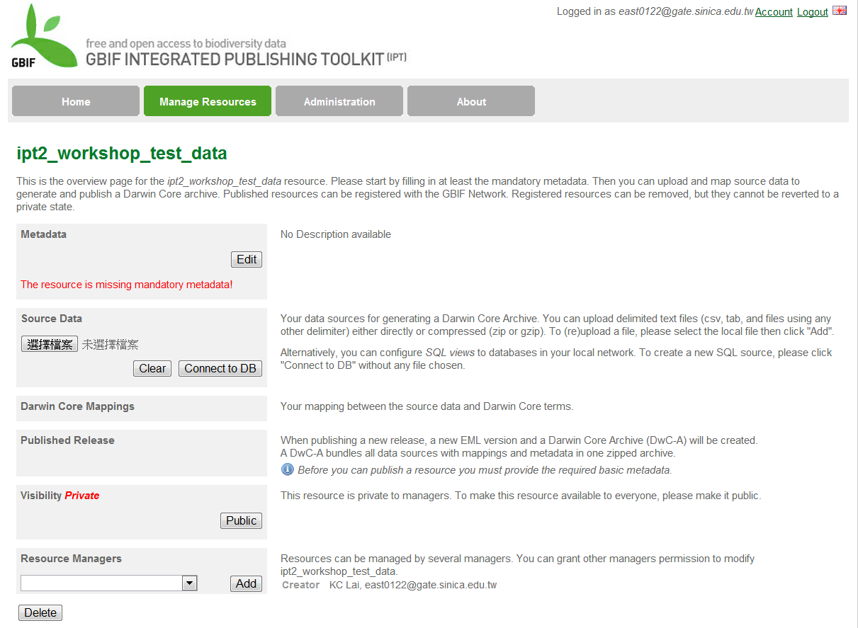
After Creating a New Folder – The Resource Overview Page

Slide 15
After Creating a New Folder – The Resource Overview Page
Resource configurations
to be added or edited

Slide 16
Metadata should allow a prospective end user of data to
identify/discover its existence,
learn how to access or acquire the data,
understand its fitness-for-use, and
learn how to transfer (obtain a copy of) the data.

Slide 17
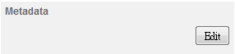
Metadata (required)
12 Sections:
Basic Metadata
Geographic Coverage
Taxonomic Coverage
Temporal Coverage
Keywords
Associated Parties
Project Data
Sampling Methods
Citations
Collection Data
External links
Additional Metadata
There is a minimum set of mandatory elements required for identification
The more elements are used, the more complete the metadata are

Slide 18
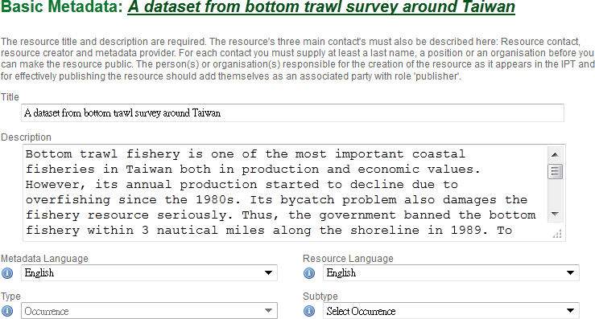
Basic Metadata(1)
Title (required)
Description(abstract in data paper)

Slide 19
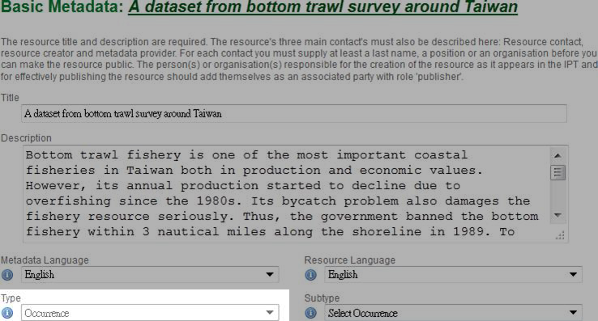
Basic Metadata(1)
Type
The value of this field depends on the core mapping of the resource and is no longer editable if the Darwin Core mapping has already been made.

Slide 20
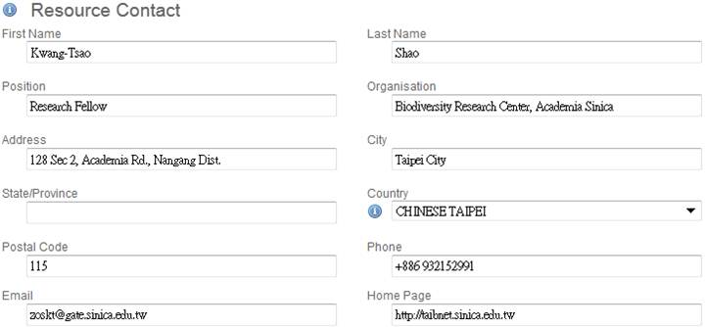
Basic Metadata(2)
Resource Contact
the person or organisation that should be contacted to get more information about the resource

Slide 21
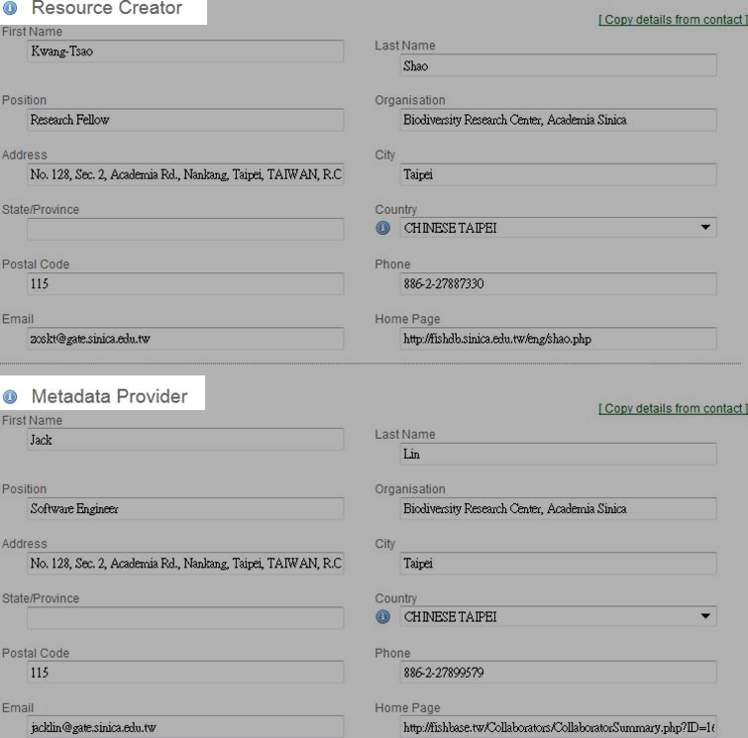
Basic Metadata(3)
the person or organisation responsible for the original creation of the resource content
the person or organisation responsible for producing the resource metadata

Slide 22
Metadata Section
Basic Metadata
Geographic Coverage
Taxonomic Coverage
Temporal Coverage
Keywords
Associated Parties
Project Data
Sampling Methods
Citations
Collection Data
External links
Additional Metadata
Information about the geographic area covered by the resource

Slide 23
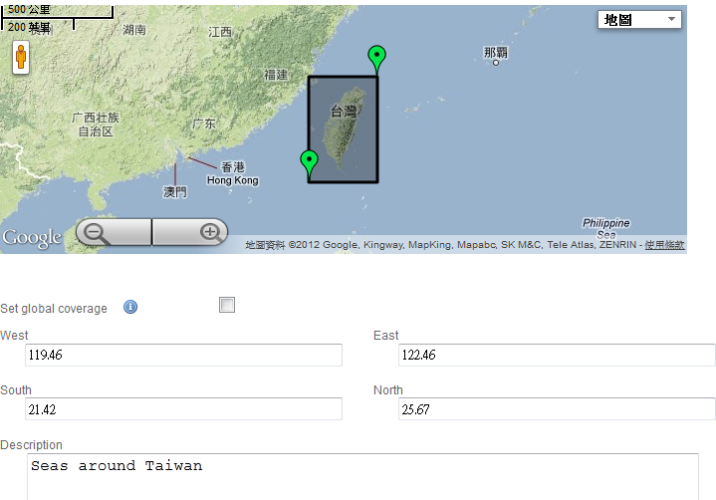
Geographic Coverage
To reset geographic bounds:
Drag markers on the map or…
Set the geographic coverage to include the whole earth
Enter latitudinal and longitudinal values
Notes:
Coverage Map - Click on a marker and drag it to a new location to reset the geographic bounds of the box. The corresponding latitude and longitude values will change to match the box on the map. Both markers can be dragged in this way. The map has common viewing features of Google Maps, including a scale bar, a select menu to view different layers (terrain, satellite imagery, etc.), and buttons to zoom in (+) and zoom out (-).

Slide 24
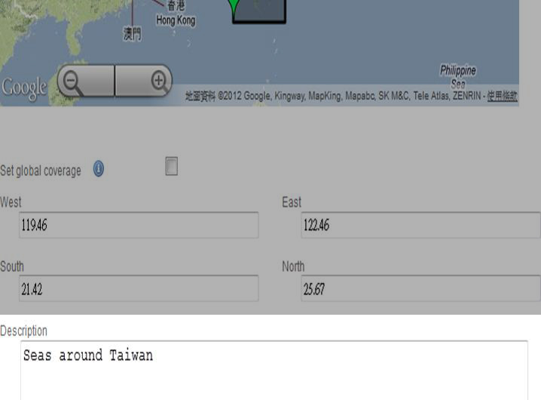
Geographic Coverage
A short text description of a dataset's geographic areal domain.
Especially important when the extent of the dataset cannot be well described by the "boundingCoordinates“
Allows description of arbitrary polygons with exclusions

Slide 25
Basic Metadata
Geographic Coverage
Taxonomic Coverage
Temporal Coverage
Keywords
Associated Parties
Project Data
Sampling Methods
Citations
Collection Data
External links
Additional Metadata
Information about one of more groups of taxa covered by the resource, each of which is a taxonomic coverage.

Slide 26
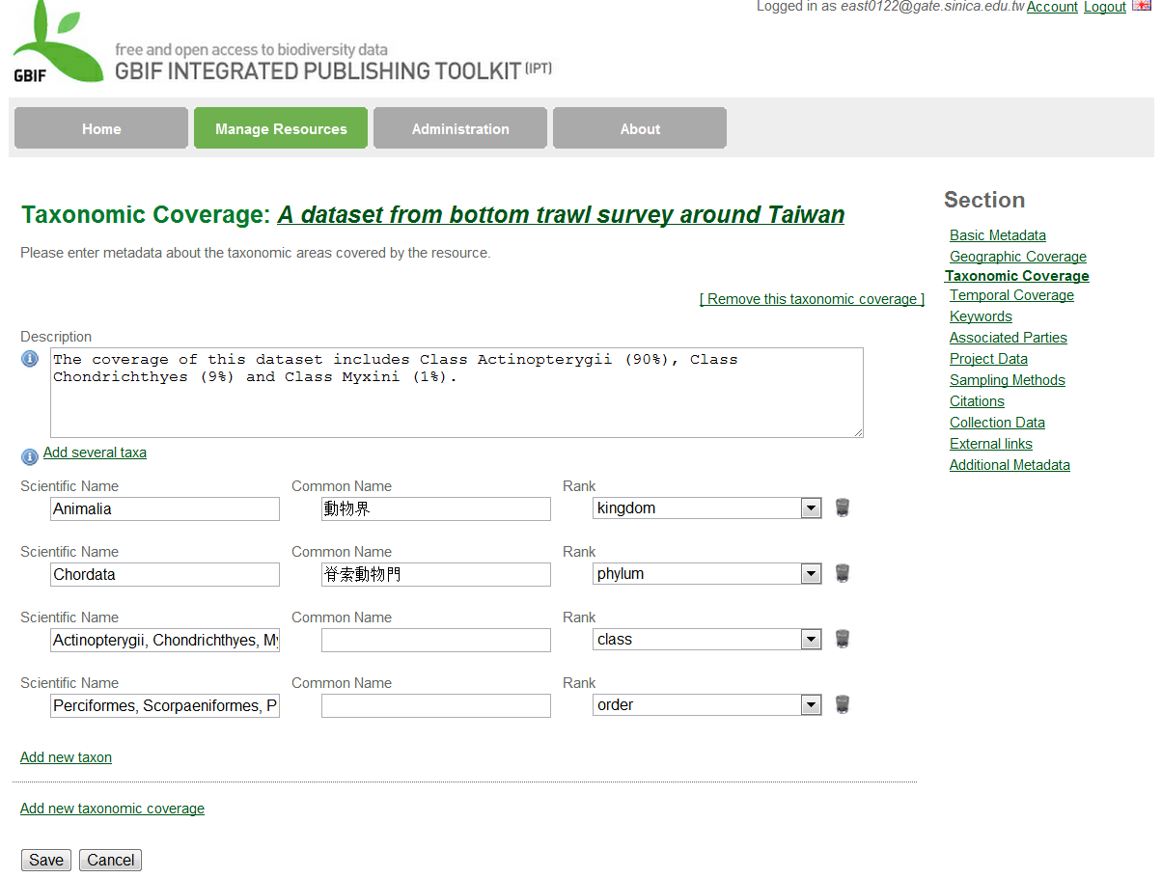
Taxonomic Coverage (1)
Taxon names
Rank

Slide 27
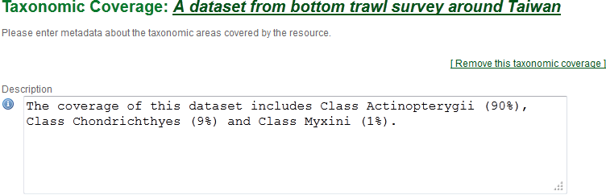
Taxonomic Coverage (2)
A textual description of a range of taxa represented in the resource.
Each taxonomic coverage has its own description.
This information can be provided in place of, or to augment the information in the other fields on the page.

Slide 28
Basic Metadata
Geographic Coverage
Taxonomic Coverage
Temporal Coverage
Keywords
Associated Parties
Project Data
Sampling Methods
Citations
Collection Data
External links
Additional Metadata
Information about one of more dates, date ranges, or named periods of time covered by the resource, each of which is called a temporal coverage
Coverages may refer to the times during which the collection or data set was assembled

Slide 29
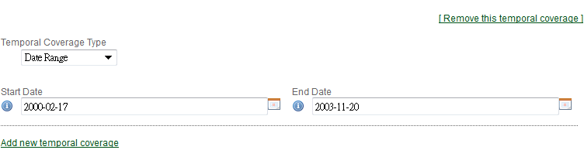
Temporal Coverage
4 Temporal Coverage Types:
Single Date – the date when a coverage is first created
Date range
Living Time Period – a named or other time period during which the biological entities in the resource were alive
Formation Period – a named or other time period during which a resource was assembled

Slide 30
Exercise 1 Create an entirely new resource Wireless AP: IPT2AP1 IPT Server: 192.168.1. 2:8080/ipt Login ID: E-Mail Password:1234

Slide 31
Basic Metadata
Geographic Coverage
Taxonomic Coverage
Temporal Coverage
Keywords
Associated Parties
Project Data
Sampling Methods
Citations
Collection Data
External links
Additional Metadata
Create one or more sets of keywords about the resource
Each set of keywords can be associated with a thesaurus that governs the terms in the list.

Slide 32
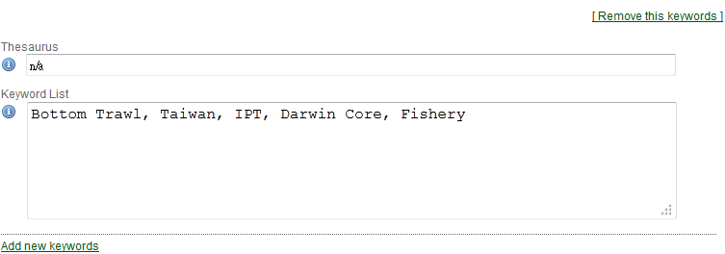
Keywords
The name of the official keyword thesaurus from which keyword was derived.
A list of keywords or key phrases that concisely describes the resource or is related to the resource.
Notes:
If an official thesaurus name does not exist, please keep a placeholder value such as “N/A” instead of removing this element as it is required together
with the keyword element to constitute a keywordSet.

Slide 33
Section
Basic Metadata
Geographic Coverage
Taxonomic Coverage
Temporal Coverage
Keywords
Associated Parties
Project Data
Sampling Methods
Citations
Collection Data
External links
Additional Metadata
Information about one or more people or organisations associated with the resource in addition to those already covered on the Basic Metadata page

Slide 34
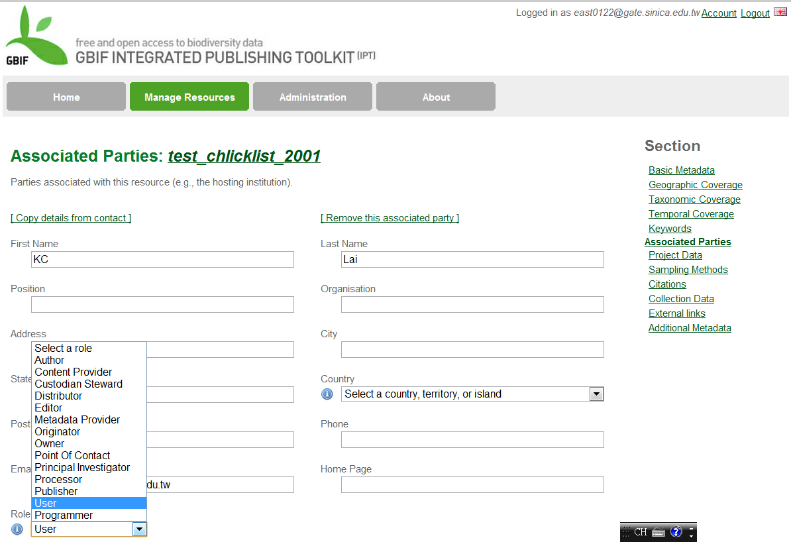
Associated Parties
a list of possible roles that the associated party might have in relation to the resource.

Slide 35
Basic Metadata
Geographic Coverage
Taxonomic Coverage
Temporal Coverage
Keywords
Associated Parties
Project Data
Sampling Methods
Citations
Collection Data
External links
Additional Metadata
Information about a project under which the data in the resource were produced.
Appropriate only if the data were produced under a single project.

Slide 36
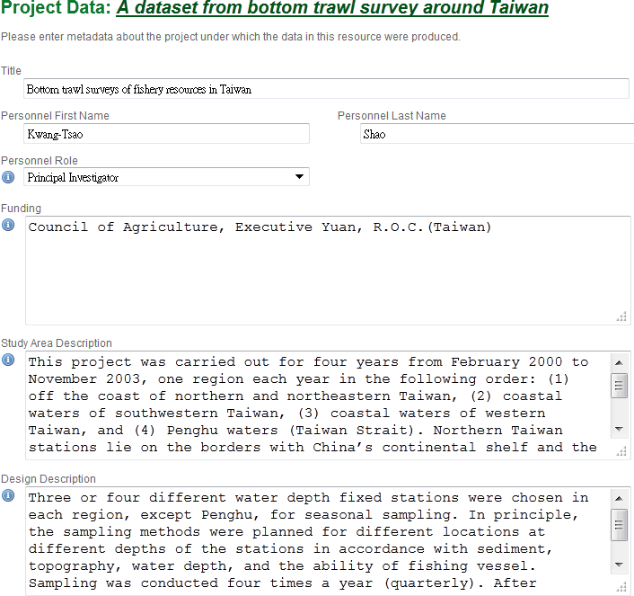
Project Data
Funding information and sources

Slide 37
Study Area Description
The physical area associated with the project
Can include the geographic, temporal, and taxonomic coverage of the research location
Design Description
General textual descriptions of research design, such as
Goals, motivations…
Theory, hypotheses…
Strategy, statistical design, and actual work

Slide 38
Basic Metadata
Geographic Coverage
Taxonomic Coverage
Temporal Coverage
Keywords
Associated Parties
Project Data
Sampling Methods
Citations
Collection Data
External links
Additional Metadata
Information about
methods used in the collection of the resource, and about items such as tools, instrument calibration and software

Slide 39
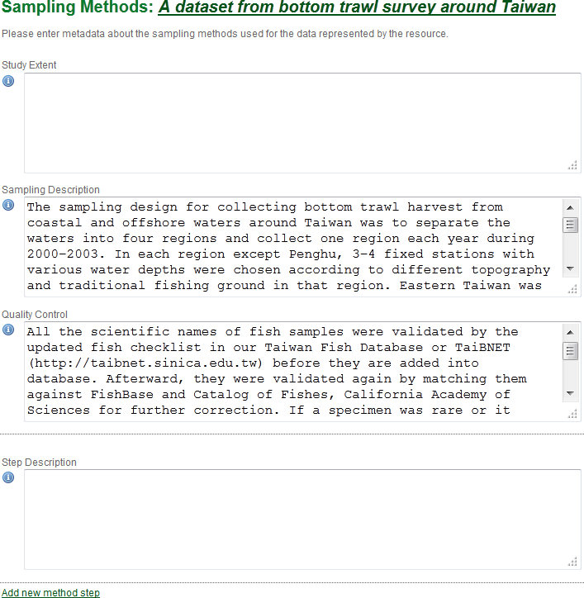
Sampling Methods

Slide 40
a description of the protocol used during sampling that resulted in the data in the resource
Sampling Description
A text description of the sampling procedures used in the research project.
The content of this element would be similar to a description of sampling procedures found in the methods section of a journal article.

Slide 41
Quality Control
The description of actions taken to either control or assess the quality of data resulting from the associated method step

Slide 42
Section
Basic Metadata
Geographic Coverage
Taxonomic Coverage
Temporal Coverage
Keywords
Associated Parties
Project Data
Sampling Methods
Citations
Collection Data
External links
Additional Metadata
Information about citations for the resource as well as the bibliography
Each Citation consists of an optional unique Citation Identifier allowing the citation to be found among digital sources and a traditional textual citation.

Slide 43
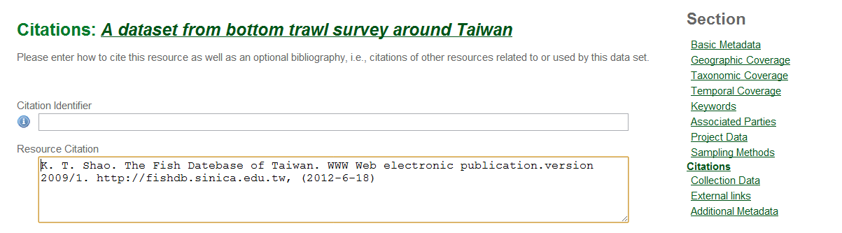
Citations
The citation for the resource itself
Citation Identifier (Optional)
The URL, DOI or other unique identifier to be used to cite the resource
Resource Citation
The traditional textual citation for the resource with author, date, and publisher information

Slide 44
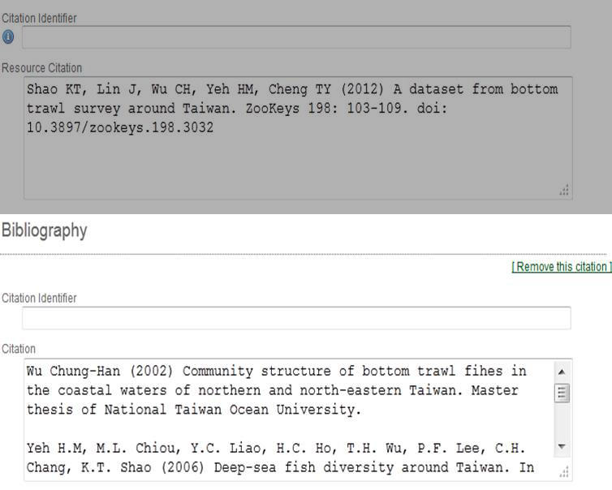
Citations
Additional citations used to produce or as a result of the production of the resource

Slide 45
Basic Metadata
Geographic Coverage
Taxonomic Coverage
Temporal Coverage
Keywords
Associated Parties
Project Data
Sampling Methods
Citations
Collection Data
External links
Additional Metadata
Information about the physical natural history collection associated with the resource (if any) as well as lists of types objects in the collection, called Curatorial Units, and summary information about them

Slide 46
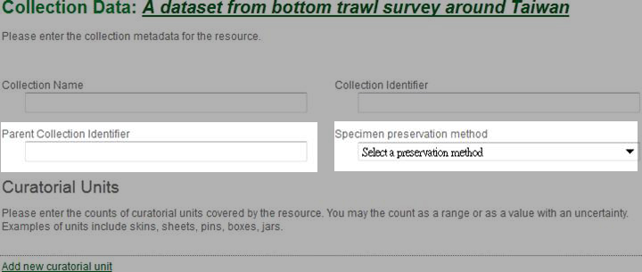
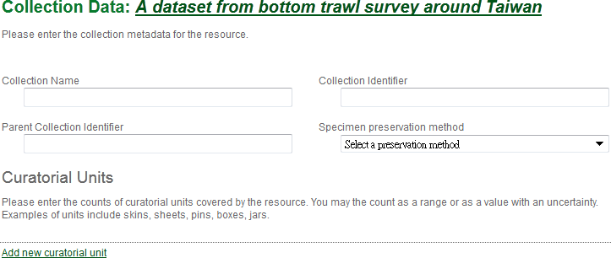
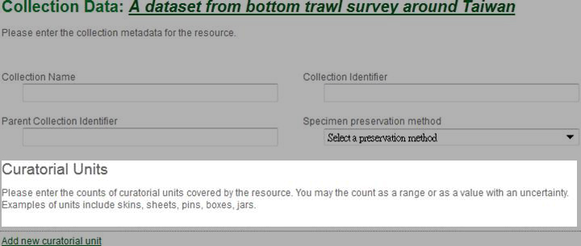
Collection Data
Collection Name
Collection Identifier
Parent Collection Identifier
Specimen preservation method
The identifier of which this collection is a subset
Specimen preservation method:
Alcohol, frozen, formalin etc.
A list of zero or more curatorial units, each consisting of a type of object (specimen, lot, tray, box, jar, etc.) and a count specified by one of two possible Method Types.
Overall, this section summarizes the physical contents of the collection by type

Slide 47
Basic Metadata
Geographic Coverage
Taxonomic Coverage
Temporal Coverage
Keywords
Associated Parties
Project Data
Sampling Methods
Citations
Collection Data
External links
Additional Metadata
Links to the home page for the resource as well as links to the resource in alternate forms (database files, spreadsheets, linked data, etc.) and the information about them

Slide 48
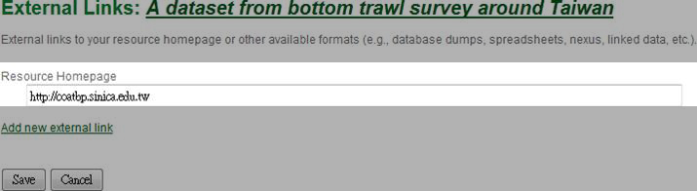
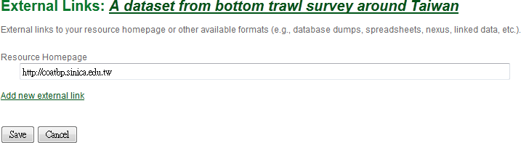
External Links
Resource Homepage

Slide 49
Basic Metadata
Geographic Coverage
Taxonomic Coverage
Temporal Coverage
Keywords
Associated Parties
Project Data
Sampling Methods
Citations
Collection Data
External links
Additional Metadata
information about other aspects of the resource not captured on one of the other metadata pages, including alternative identifiers for the resource

Slide 50
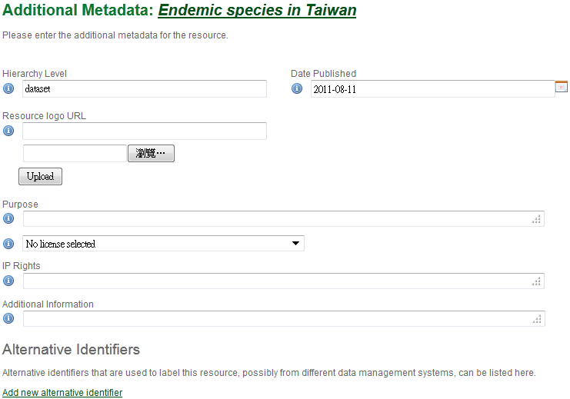
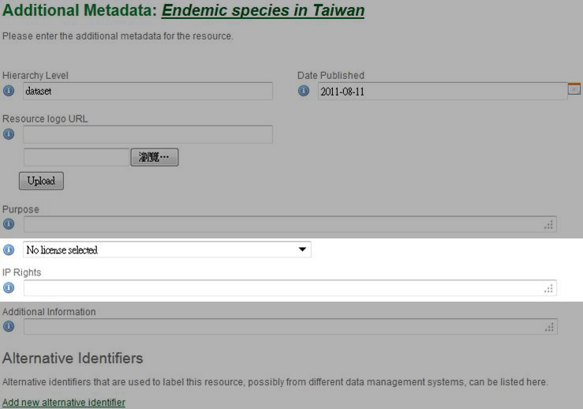
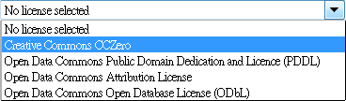
Additional Metadata
A statement of the intellectual property rights associated with the resource or a reference to where to find such a statement
IP Rights
Select 1 from 4 licenses

Slide 51
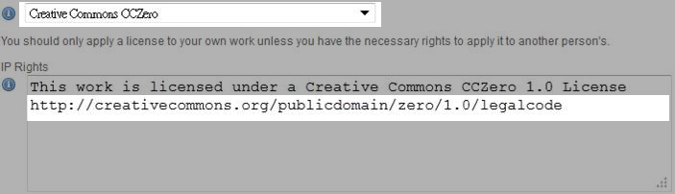
Additional Metadata
On saving the page the user is asked to confirm that they have read and understood the license

Slide 52
Exercise 2 Complete the rest of the Metadata Wireless AP: IPT2AP1 IPT Server: 192.168.1. 2:8080/ipt Login ID: E-Mail Password:1234

Slide 53
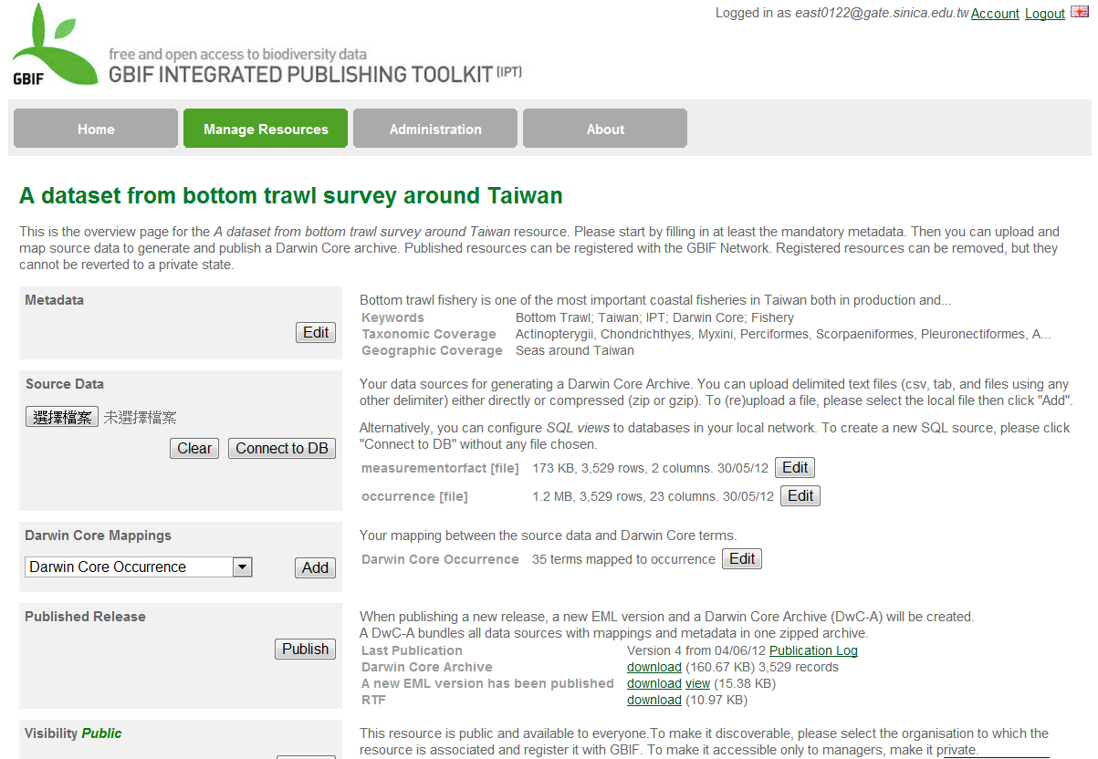

Next Section
Source Data (text, SQL)
Source Mappings
Published Release
Visibility

Slide 54
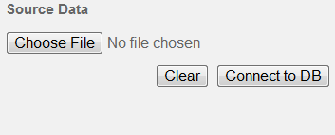
Source Data (optional)
Your data sources for generating a Darwin Core Archive. You can upload delimited text files (csv, tab, and files using any other delimiter) either directly or compressed (zip or gzip). To (re)upload a file, please select the local file then click "Add".
Import primary data from files or databases into the IPT
1 resource can be connected to >1 data source if the sources are related to each other
2 types of source data can be uploaded:
Files
Databases
Notes:
If a resource has no source data it is considered a metadata-only resource, with information about a data set or collection, but without any primary data.

Slide 55
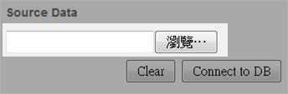
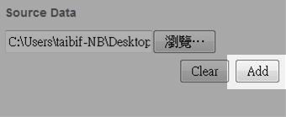
Source Data: File as Source
Select a file
The IPT can import
Uncompressed delimited text files (csv, tab, and files using any other delimiter)
equivalent files compressed with zip or gzip.
Click “Add” to enter
Source Data File detail page
Be aware of overwriting a file with the same name
Notes:
(if there is the risk of overwriting a file with the same name, a dialog opens that asks the user to confirm they actually want to overwrite it)

Slide 56
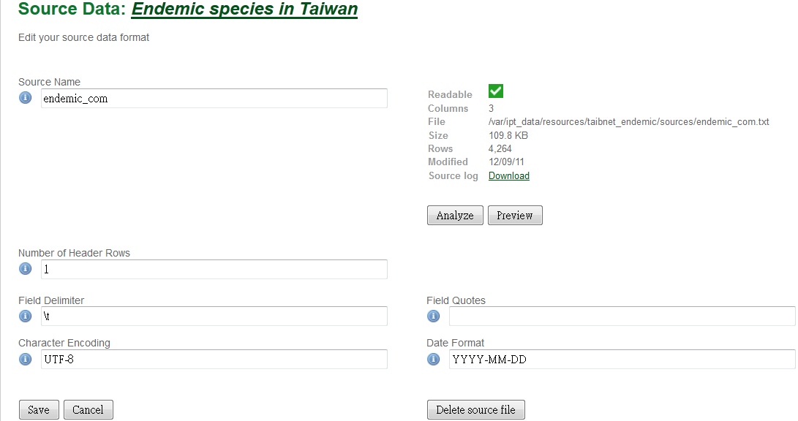
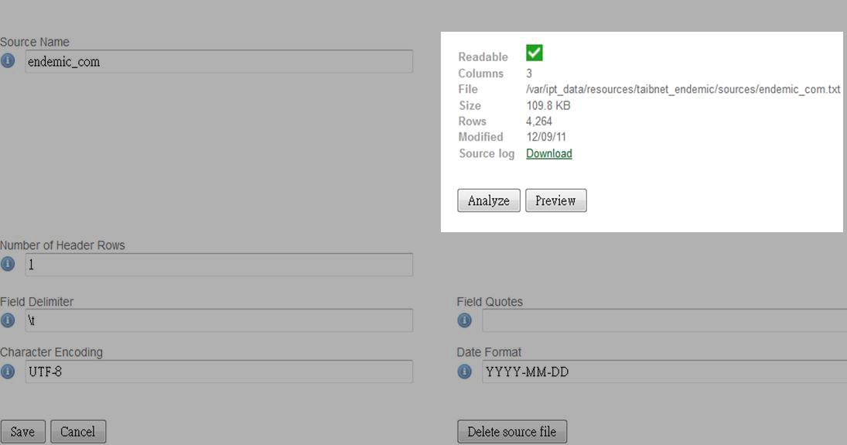
Source Data File Detail Page (1/3)
Edit the source data format
Source Name
Data summary based on current parameter settings
(cannot be edited)
Number of Header Rows
Field Delimiter
Field Quotes
Character Encoding
Date Format
Notes:
The Source Data File detail page allows the user to view and edit the parameters that describe the content of the selected file, and to use these settings to analyze and preview the file.

Slide 57
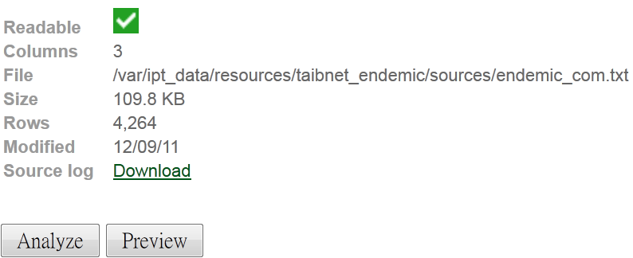
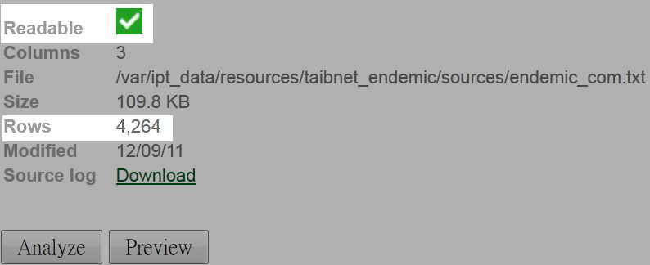
Source Data File Detail Page (2/3)
Data Summary
This icon indicates whether data are accessible using the file format information provided on this page
The number of rows found in the data file. (Note: This number helps check if all records are identified.)
Notes:
The analysis will indicate whether the database is readable, and if so, how many columns there are in the results of the SQL Statement.

Slide 58
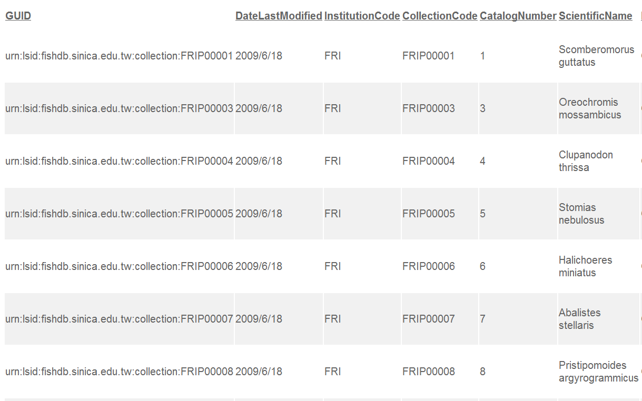
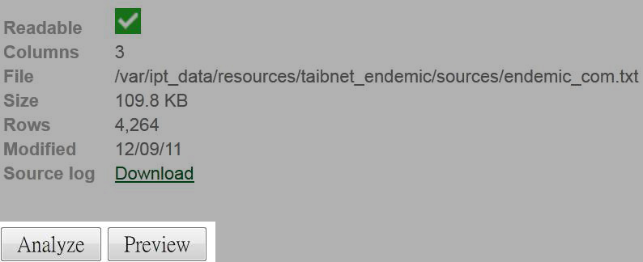
Source Data File Detail Page (2/3)
Data Summary
Click to preview the file based on the parameter settings on this page
After the parameters on this page are set, click “Analyze” to generate a new data summary
Notes:
The analysis will indicate whether the database is readable, and if so, how many columns there are in the results of the SQL Statement.

Slide 59
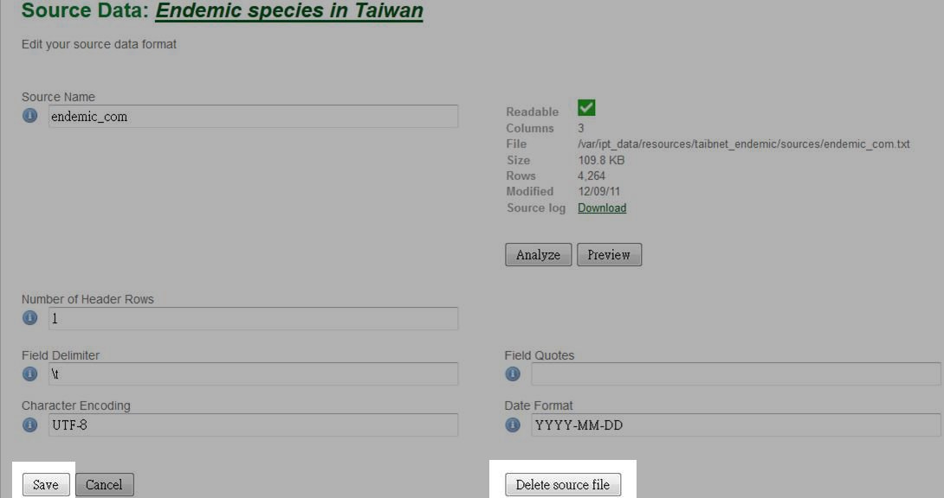
Source Data File Detail Page (3/3)
Click to save the configuration and return to the Resource Overview page
Click to delete the source file and any associated mappings

Slide 60
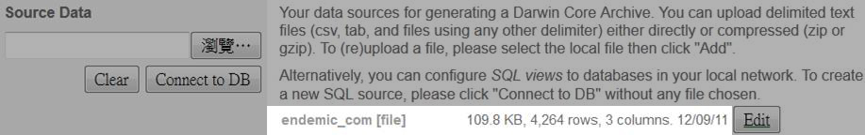
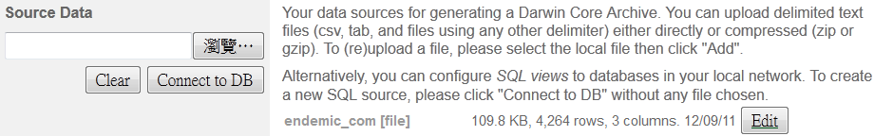
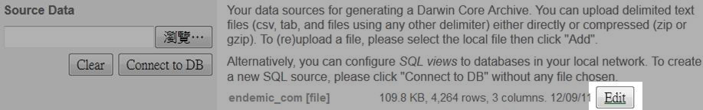
Source Data: File as Source
The imported file with summary information
Click to reopen the Source Data File detail page to edit the format
To import more files:
Repeat the uploading process
Import a zipped folder with multiple text files in one try

Slide 61


Source Data: Database as Source
Click to enter Source Database detail page
Supported databases
Microsoft SQL Server
MySQL
ODBC (Sun Java5)
Oracle
PostgreSQL
Sybase database
Notes:
(if there is the risk of overwriting a file with the same name, a dialog opens that asks the user to confirm they actually want to overwrite it)

Slide 62

Source Database Detail Page
(can be edited and given any name)
Source Name
Host: 127.0.0.1
Database:ipt_test
Database user: ipt2
ipt2
SQL Statement
Select * From occurrences
Character Encoding: UTF-8
Notes:
SQL Statement - The Structured Query Language statement used to read data from the source database. The statement will be sent as-is to the configured database, so you can use any native feature of the database such as functions, group by statements, limits, or unions, if supported. Example:`SELECT * from specimen join taxon on taxon_fk=taxon.id`. While testing a large data source it is a good idea to include the appropriate language in the SELECT statement to limit the number of rows returned by the query - for example, in MySQL, `SELECT * from specimen join taxon on taxon_fk=taxon.id` LIMIT 10. When the statement has been fully tested with the Darwin Core Mappings (see the following section of the Quick Reference Guide), change the SQL Statement to return the full intended data set.
Character Encoding - the system that defines byte-wise definitions of the characters in the data (e.g., Latin1, UTF-8 ).

Slide 63

Source Database Detail Page
Data summary based on current parameter settings
Notes:
SQL Statement - The Structured Query Language statement used to read data from the source database. The statement will be sent as-is to the configured database, so you can use any native feature of the database such as functions, group by statements, limits, or unions, if supported. Example:`SELECT * from specimen join taxon on taxon_fk=taxon.id`. While testing a large data source it is a good idea to include the appropriate language in the SELECT statement to limit the number of rows returned by the query - for example, in MySQL, `SELECT * from specimen join taxon on taxon_fk=taxon.id` LIMIT 10. When the statement has been fully tested with the Darwin Core Mappings (see the following section of the Quick Reference Guide), change the SQL Statement to return the full intended data set.
Character Encoding - the system that defines byte-wise definitions of the characters in the data (e.g., Latin1, UTF-8 ).

Slide 64
Exercise 3 2 types of source data can be uploaded: - Files - Databases

Slide 65

Data Mapping

Slide 66

Darwin Core Mappings
Map the fields in the incoming data to fields in installed extensions
See which fields from the sources have not been mapped
Only available after at least 1 data source has been successfully added and at least 1 extension has been installed
Notes:
A select box with a list of Core Types and Extensions will show

Slide 67




Darwin Core Mappings
Core Types
Extensions

Slide 68

Data Source selection page
Select the data source file to map
Click to start mapping
Notes:
This page gives an explanation of the type of data the extension is meant to support, and shows a select box containing a list of all of the configured data sources.

Slide 69

Data Mapping Detail Page
Notes:
The Data Mapping page allows a user to specify exactly how the data accessible through this IPT resource are to be configured based on the selected extension.

Slide 70

Data Mapping Detail Page

Slide 71

Data Mapping Detail Page
Jump to Different sets of related extension fields

Slide 72

Data Mapping Detail Page
Darwin core term

Slide 73

Data Mapping Detail Page
Fields are automatically mapped if the field names match the Darwin core term.

Slide 74

Data Mapping Detail Page
Unmapped extension fields

Slide 75


Data Mapping Detail Page
Field names from source data

Slide 76
Data Mapping Detail Page
select boxes
text boxes

Slide 77


Mapping by user
Unmapped extension fields

Slide 78

Constant value text box
To set the published value of any non-identifier extension field to a single value for every record in the data source

Slide 79

Unmapped columns

Slide 80
Exercise 4 Data Mapping - Taxon Mapping - Occurrences Mapping

Slide 81
Published Release
Publish a release (version) of the resource
By clicking “Publish,” 4 things are accomplished

Slide 82
First
The current metadata are written to the file eml.xml in the directory matching the resource's Shortname within the directory named "resources" in the IPT data directory.
The current metadata are also saved in the same location as an incremental version of the EML file named eml-n.xml, where n is the incremental version number reflecting the number of times the EML file has been published.
Notes:
xxxxx

Slide 83
Second
The current primary resource data as configured through mapping (see the "Darwin Core Mappings" section under the "Resource Overview" heading in the "Manage Resources Menu" section) are written to the Darwin Core Archive file named dwca.zip in the same resource directory within the IPT data directory.

Slide 84
Third & Fourth
A data publication document (Data Paper) in Rich Text Format (RTF) is generated.
The information about the resource is updated in the GBIF Registry if the resource is registered.

Slide 85
Finally
A Publishing Status page will show status messages highlighting the success or failure to publish each of the documents, as well as the detailed results of the publishing process.

Slide 86

Publishing Status page
Notes:
Publication log - This link initiates a download of a file named "publication.log", which contains the detailed output of the publication process. This file will contain specific information about any records that might have failed to load. For example, the log file will show the contents of records having a number of columns that does not match the mapped columns.

Slide 87

Publishing Status page
Click to download the file “publication.log”,
which contains the detailed output of the
publication process
a summary of the information that was sent to the filed named “publication.log”
Notes:
Publication log - This link initiates a download of a file named "publication.log", which contains the detailed output of the publication process. This file will contain specific information about any records that might have failed to load. For example, the log file will show the contents of records having a number of columns that does not match the mapped columns.

Slide 88

Published Release
Summary information about the published release
serial integer version and date of the latest publication
"See Report" to view the publication log summary
download the Publication Log file
download the Darwin Core Archive file
download the EML file
view the metadata contained in the EML file
download the RTF data publication document

Slide 89
Visibility
Determine who will be able to view a resource, whether viewing is
private,
public, or
discoverable through the GBIF Registry (registered)

Slide 90
Visibility - Private
The resource is…
Visible only to
users who created it, or
users who have been granted permission to manage it within the IPT, or
users who have the Admin role
Default setting: Private

Slide 91

Visibility - Public
A public resource is visible to anyone using the IPT instance.
But the resource is not discoverable until it has been registered with the GBIF Registry.

Slide 92
Exercise 5 Data publish and data public

Slide 93
Thank You!
http://taibif.tw

